Slide 1
Network Programming
Final
201158054 신동호
201158102 서창욱

Slide 2
CONTENTS
01 Subject Overview
02 Introduction to Software
03 Software Algorithm & Design
04 Demo & Practical Example
05 In Closing Project
Ⓒ미니블로그 PPT TEMPLATE http://minheeblog.tistory.com

Slide 3
01
Subject Overview
Ⓒ미니블로그 PPT TEMPLATE http://minheeblog.tistory.com

Slide 4

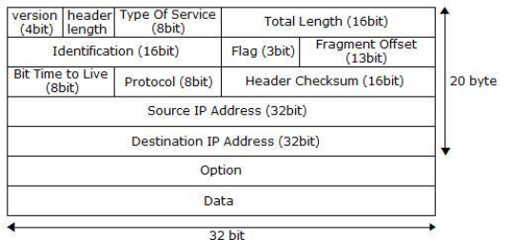

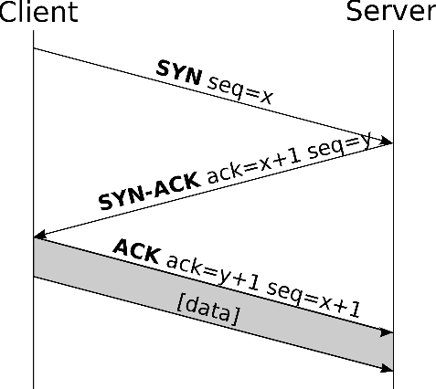
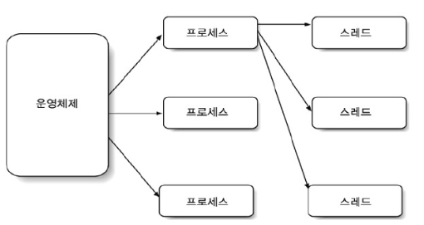
01
Subject Overview
Network Programming finish during the semester
Security Program Development
….

Slide 5
02
Introduction to Software

Slide 6



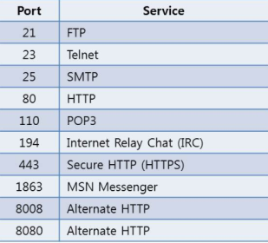
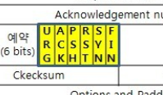

02
Introduction to Software
Security program to block the abnormal packet
Invalid IP, abnormal Control-Bit, ACCEPT / DROP Port
FireWall Program
….

Slide 7
03
Software
Algorithm & Design

Slide 8
03
Software Algorithm & Design
User Algorithm
Start Programs
Setting the rules
Select the filtering combination
Packet Filtering starts
Packet filtering exit
End of program

Slide 9
03
Software Algorithm & Design
<<Prototype>>
Introduction to Windows Firewall settings

Slide 10
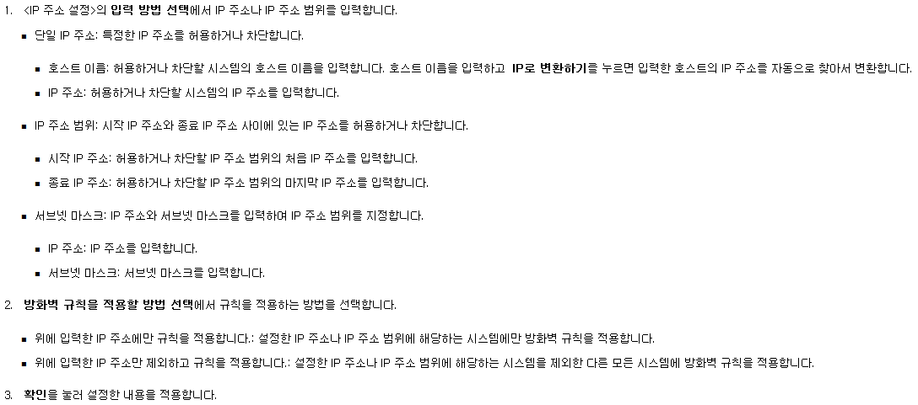
03
Software Algorithm & Design
Prototype models - Windows Firewall settings (1)
Reflected in the program
Not Reflected in the program
Reflected in the program

Slide 11
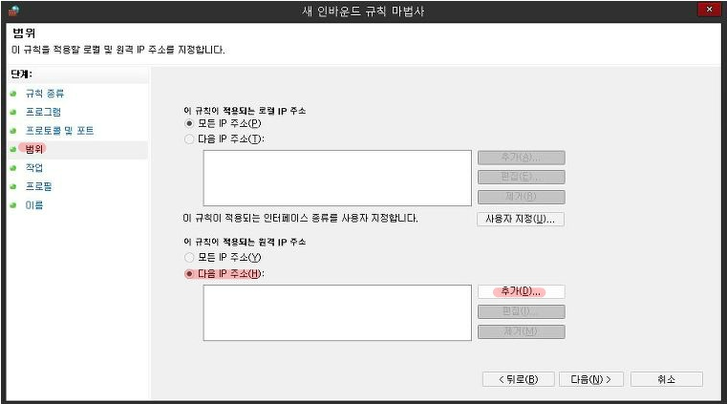
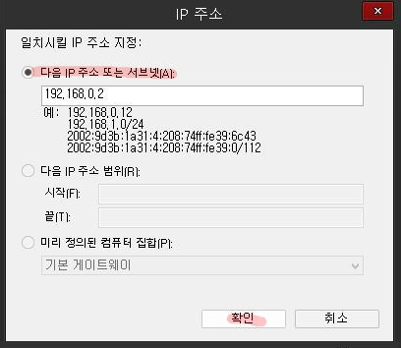
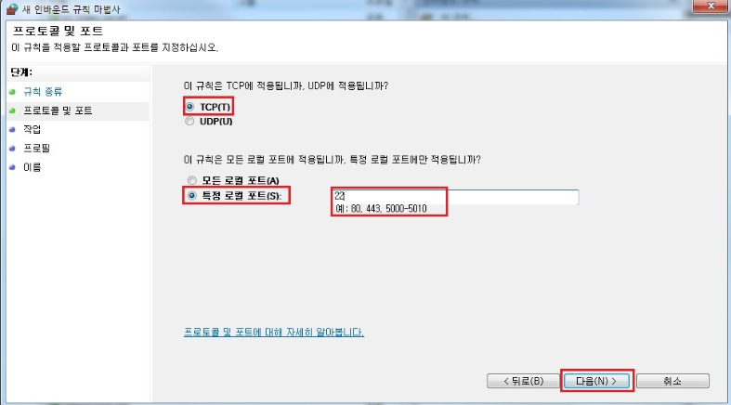

03
Software Algorithm & Design
Prototype models - Windows Firewall settings (2)
GUI(Graphic User Interface)
Mode

Slide 12
03
Software Algorithm & Design
<<Program Info>>
Introduction to ‘my_firewall’ Firewall settings

Slide 13
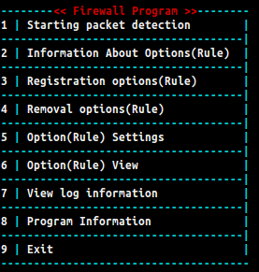

03
Software Algorithm & Design
Introduction menus and options
SELECT
USER

Slide 14
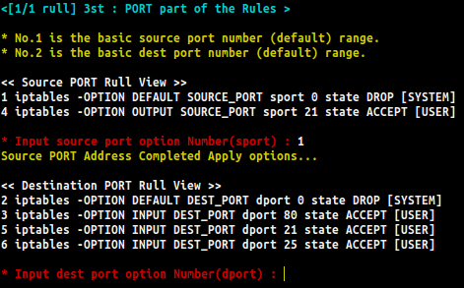

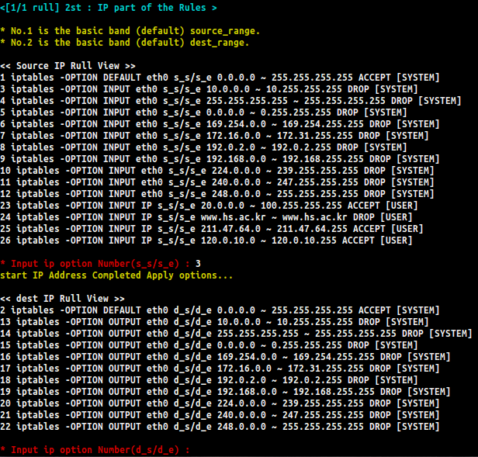
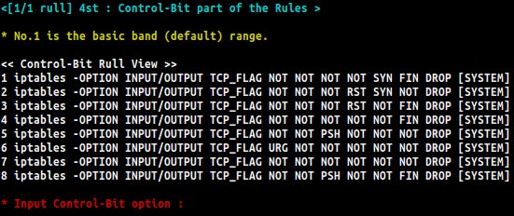
03
Software Algorithm & Design
Introduction Rule set Stage
Consol Mode

Slide 15
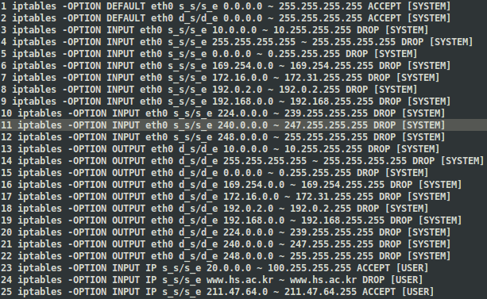
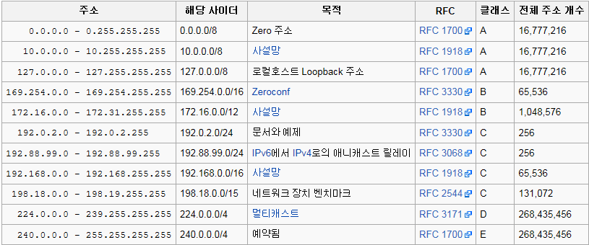
03
Software Algorithm & Design
Introduction Rules – IP Rule
Apply IP
USER

Slide 16

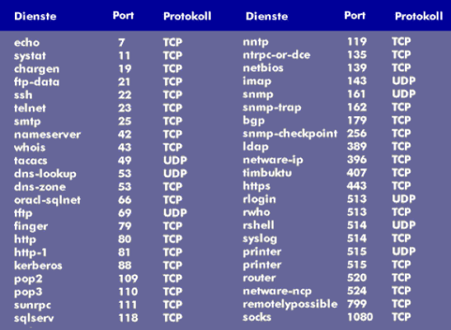
03
Software Algorithm & Design
Introduction Rules – Port Rule
Apply PORT
USER

Slide 17
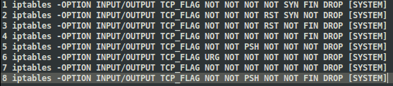
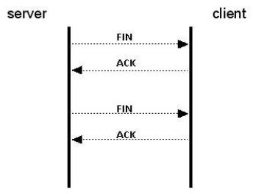
03
Software Algorithm & Design
Introduction Rules – Control-Bit Rule
USER

Slide 18
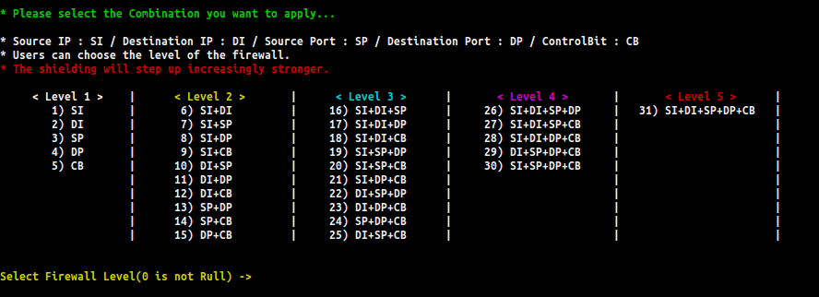
03
Software Algorithm & Design
Introduction Rules – Firewall level set
This program offers a combination of firewalls.
1 level (low) ~ 5 level (high)

Slide 19
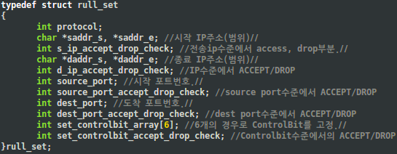

Initialization Rules
Protocol Definition
TCP(6)
IP addresses define (All = NULL)
ACCEPT (1) / DROP (0) definition
Port addresses define (All = 0)
ACCEPT (1) / DROP (0) definition
Control bits defined (NOT = 0)
ACCEPT (1) / DROP (0) definition
IP Rule
PORT Rule
CB Rule
Apply rules

Slide 20
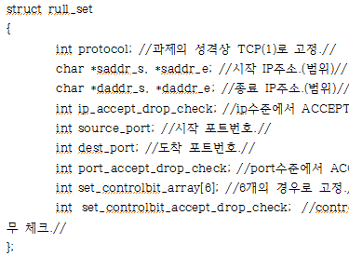
Starting packet filtering
IP, TCP 헤더정의
Recvfrom()으로 패킷을 받아오기
IP, TCP헤더에 맞게 패킷정보 분할
Protocol
IP
PORT
CB
중첩 if/else이용
IP대역(범위) 허용 불가(DROP)/가능(ACCEPT)을 판단.
포트번호 허용(ACCEPT)/불가(DROP) 판단.
ACCEPT 옵션 경우
(범위 안 S,D 포함, 포트 허용)
DROP 옵션 경우
(범위 밖 S,D 미포함, 포트 불가)
ControlBit 허용(ACCEPT)/불가(DROP) 판단.
패킷 비교 작업 완료
처리결과에 따른 적절한 로그파일에 기록(허용/차단기록)
End packet filtering

Slide 21

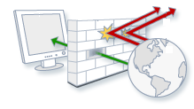
Main Thread
1. Starting packets
track
2. rule / not_rule
selection
Rule
Not_Rule
Thread()
Receive
Filtered packets
While(1){
‘end’ for wait
}
Start Menu
Receive all packets
Input : ‘end’
Send your Dummy packet

Slide 22
03
Software Algorithm & Design
Limitations of the current program
Not handle many possible exceptions exist - Unstable
Initializes all registration existing rules are rules
Did not solve the memory leak problem is likely to exist
IP input slash notation applies to non - users directly calculated

Slide 23
04
Demo &
Practical Example

Slide 24
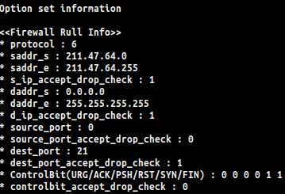

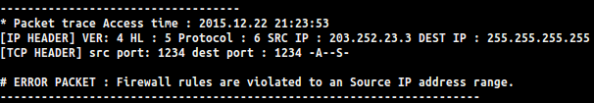
04
Demo & Practical examples
* Situation 1
-> 특정한 IP대역에서만 FTP서비스를 허용하기 위해 211.47.64.0/24 대역에서
21번으로 향하는 초기 패킷(NEW)은 허용
Log Info

Slide 25
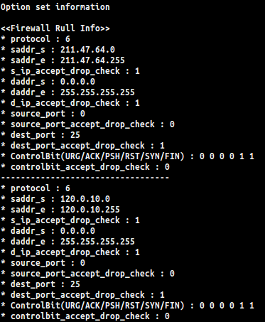
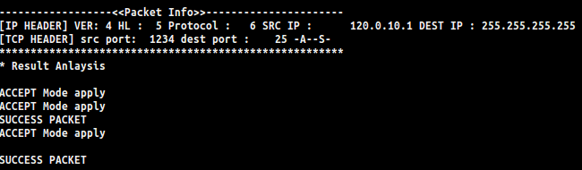

04
Demo & Practical examples
* Situation 2
-> SMTP 서비스를 허용하기 위해 211.47.64.0/24 , 120.0.10.0/24 대역에서 25번
으로 향하는 초기(NEW) 패킷은 허용
Log Info

Slide 26
04
Demo & Practical examples
Program Demo

Slide 27
05
In Closing
Project

Slide 28
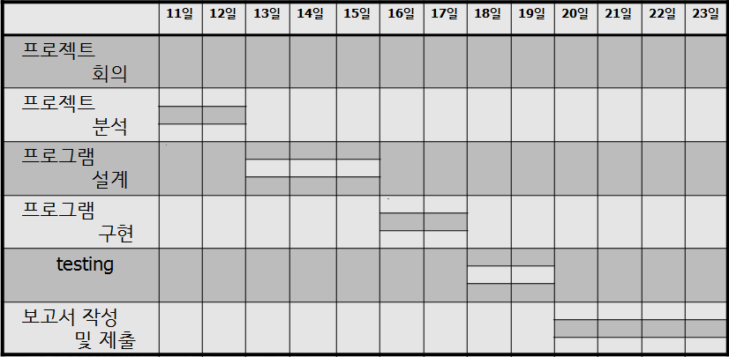
05
In Closing Project
Roles and the development schedule
Role
* 서창욱 : 전체 프로그램 시나리오 구성
* 신동호 : 멀티 스레드 구현 및 인터페이스 구성
* 공동작업 : 룰 규칙 구성, 예외처리 작업
development schedule

Slide 29
05
In Closing Project
협동심
자신감

Slide 30

05
In Closing Project
Q & A

